Slide 2
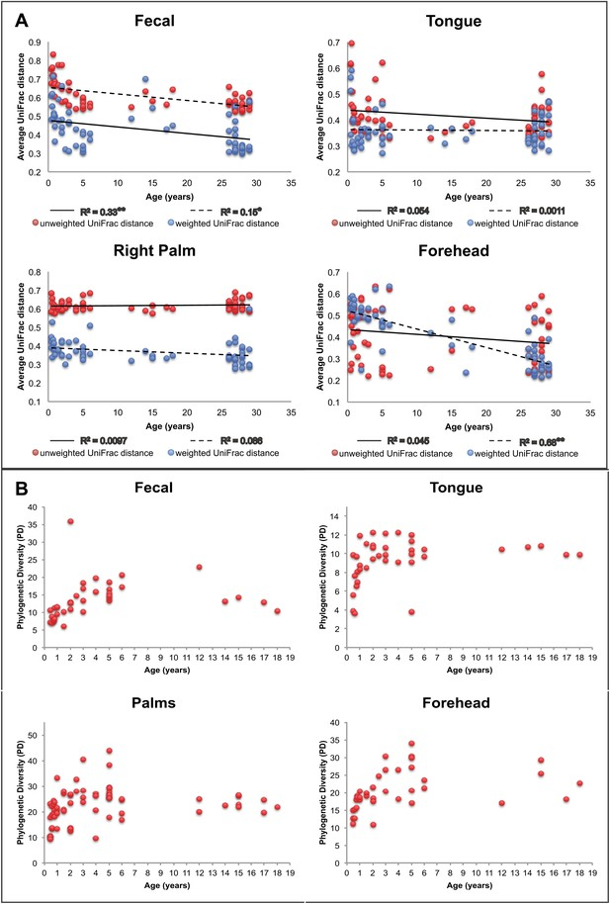

Slide 3
Phylogenic Diversity (PD)
Age (years)

Slide 4
